Slide 1
VIII SUMMIT OF THE AMERICAS
Grupo de Trabajo Cumbre de las Américas
Lima, april 2018

Slide 2
SUMMIT’s VENUES

Slide 3
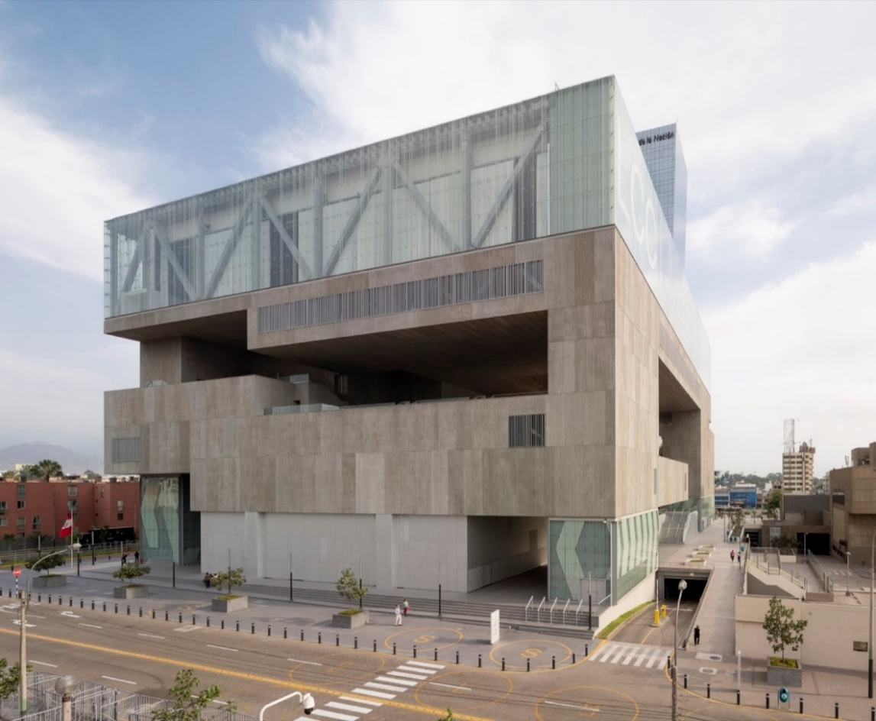
VIII SUMMIT OF THE AMERICAS: Lima Convention Center

Slide 4
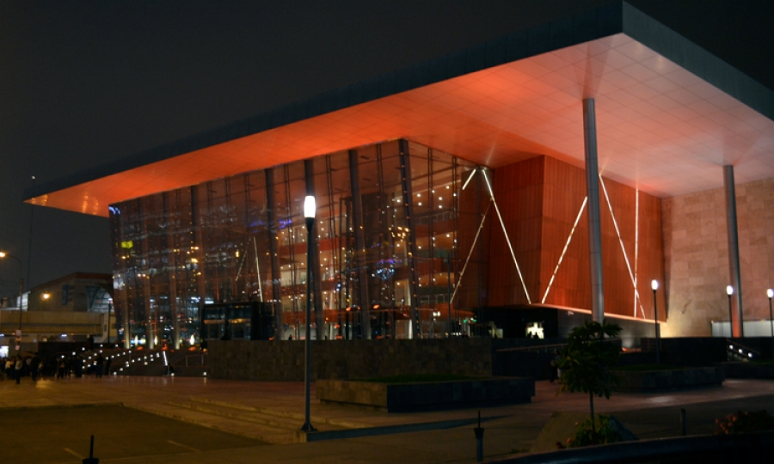
Opening Ceremony: National Grand Theater

Slide 5
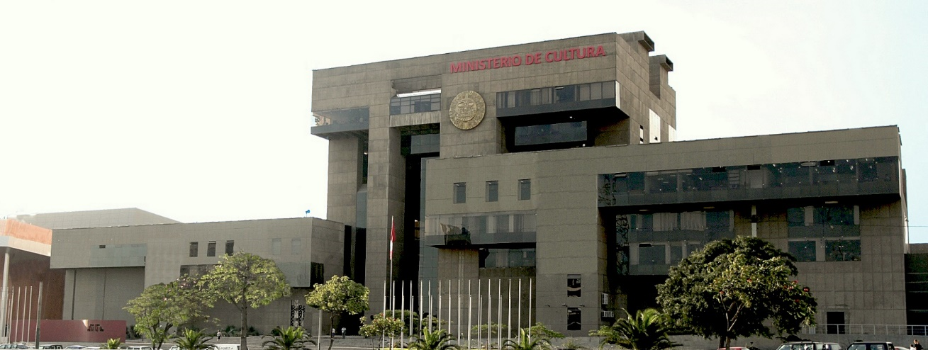
Media Center: Ministry of Culture

Slide 6
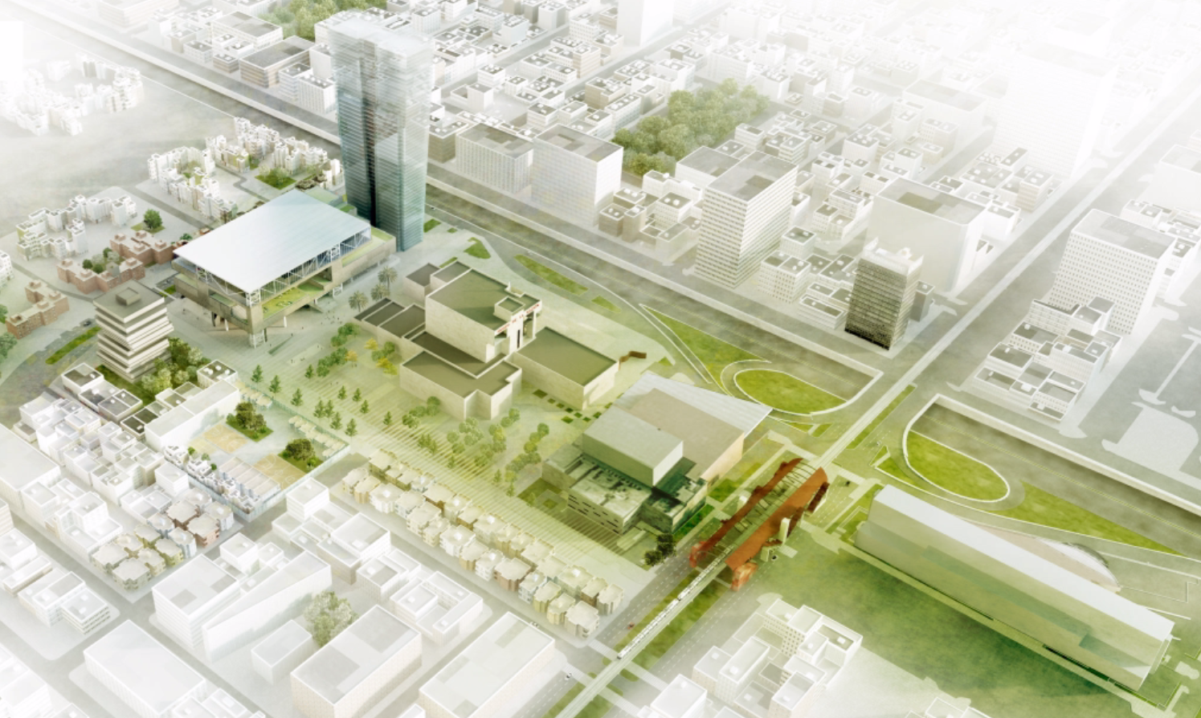
SUMMIT’s VENUES
(NATIONAL CULTURAL CENTER)
NATIONAL BANK
LIMA CONVENTION CENTER
MINISTERY OF CULTURE
NATIONAL GRAND THEATER
NATIONAL LIBRARY

Slide 7
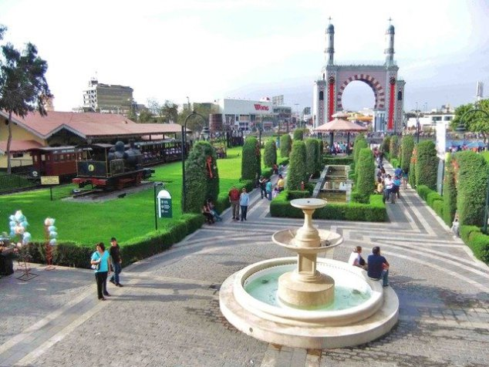
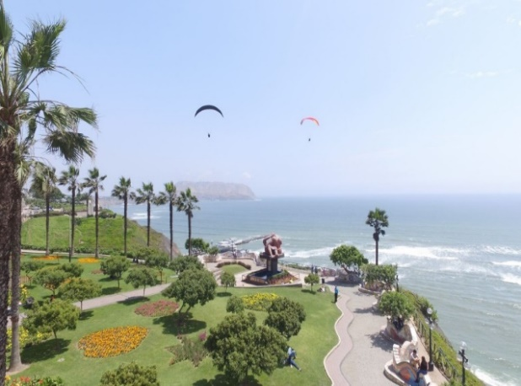
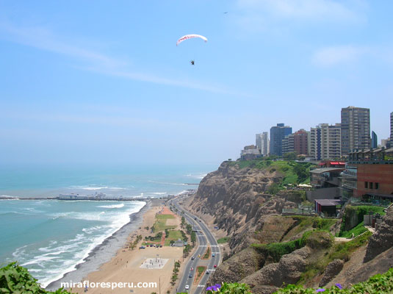
VENUES FOR RELATED EVENTS

Slide 8
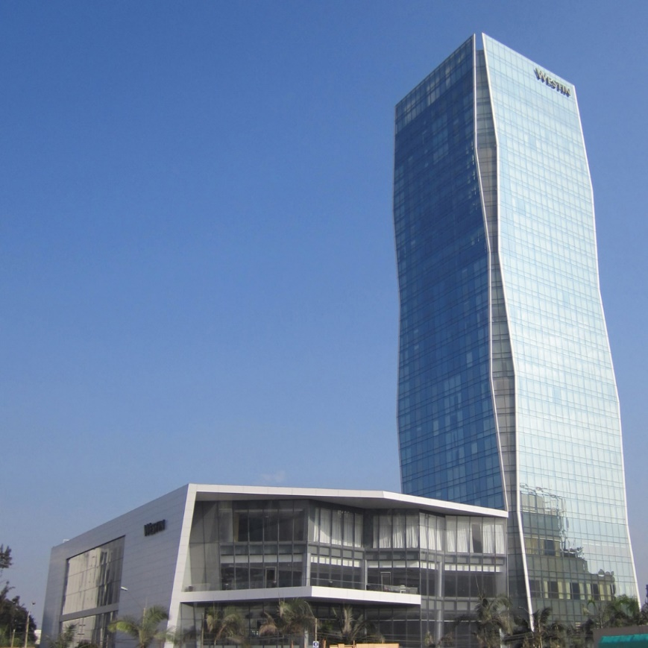
CEO Forum: The Westin Lima Hotel & Convention Center

Slide 9
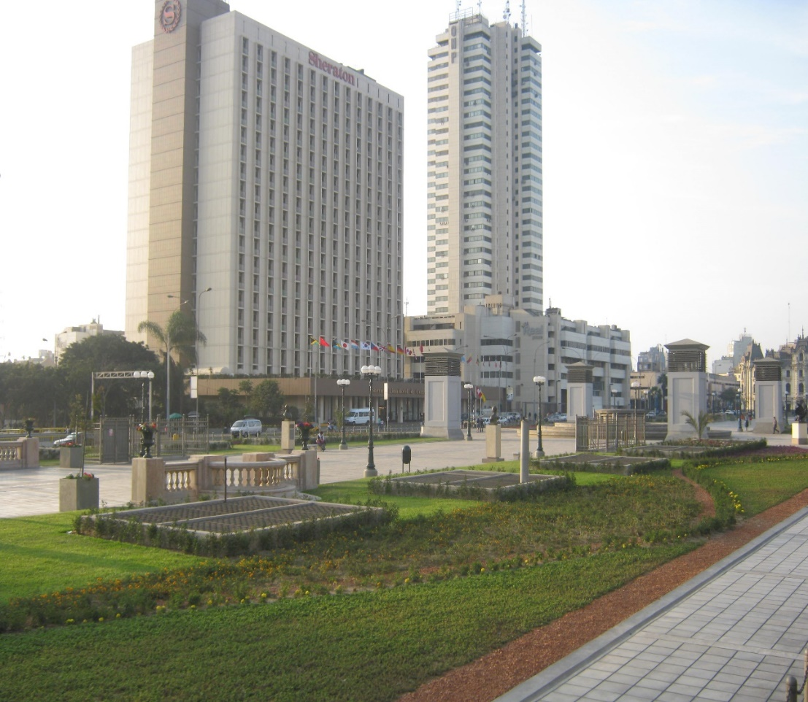
Civil Society Forum: Sheraton Lima Hotel

Slide 10
Youth Forum for the Summit of the Americas
Venue: TBC

Slide 11
FACILITIES OFFERED BY THE PERUVIAN GOVERNMENT

Slide 12
Airport
The Heads of State and/or Governmente who arrive in their official Planes, will have protocol reception in the Air Base N ° 2 (Air Group N ° 8).
The Heads of State/or Governmente who arrive on commercial flights will have protocol reception at the Jorge Chávez International Airport.

Slide 13
Security
Appropriate security will be provided to the Heads of State/Government and their delegations.
The Lima Convention Center, the Ministry of Culture, and the National Grand Theater, will be closed to the public during the realization of the event.
External security will be provided by Security of the State. Internal security facilities will also be given by a private security company.
Security rings will be set up around the National Cultural Center and Official Hotels.

Slide 14
Transportation
1 vehicle will be provided for the Head of State and/or Government, 1 vehicle for the Minister of Foreign Affairs and 1 vehicle for the National Coordinator.
Likewise, transportation will be provided for the rest of the delegations.

Slide 15
Accommodation
The Peruvian Government will cover the cost of the rooms of the Head of State and/or Government, the Minister of Foreign Affairs and the National Coordinator for each participant country.
Additionally, a list of suggested 4-star hotels for the accommodation of delegations will be sent soon. These hotels are near to the official hotels.

Slide 16
Liaisons
All delegations will be assigned a diplomatic liaison officer during their stay in Lima.

Slide 17
Additional Information:
A Summit Preparatory Meeting will be held in Lima in February 2018 to provide logistical details about the VIII Summit of the Americas in Lima.
The assistance of officials or specialists from each delegation will be required in the following areas:
- Protocol
- Security
- Press

